Slide 1
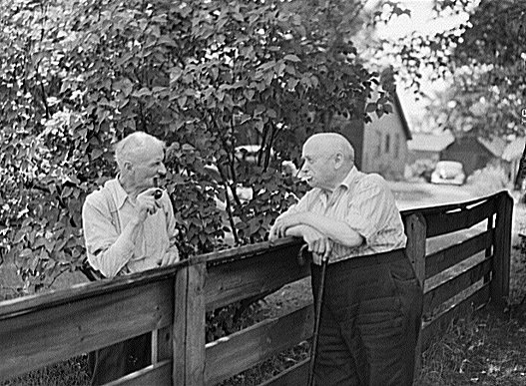
The Bad Neighbor
Hardware Side Channels in Virtualized Environments

Slide 2

Who I am
Sophia D’Antoine
Security Researcher at Trail of Bits
Masters in Computer Science from RPI
Thesis on Hardware Side Channels
I play CTF

Slide 3
Overview
Side channel attacks
Side channel mediums: Hardware
Vulnerabilities in the cloud
Demo
Defenses
The future

Slide 4
What are side channel attacks?
Attacks:
Leak information from or alter behavior of a system or process.
Side channel:
Attack does not alter or introspect into the program itself.

Slide 5
What are side channel attacks?
Attacker can observe the target system. Must be ‘neighboring’ or co-located.
Ability to repeatedly query the system for leaked artifacts.
Artifacts: changes in how a process interacts with the computer

Slide 6
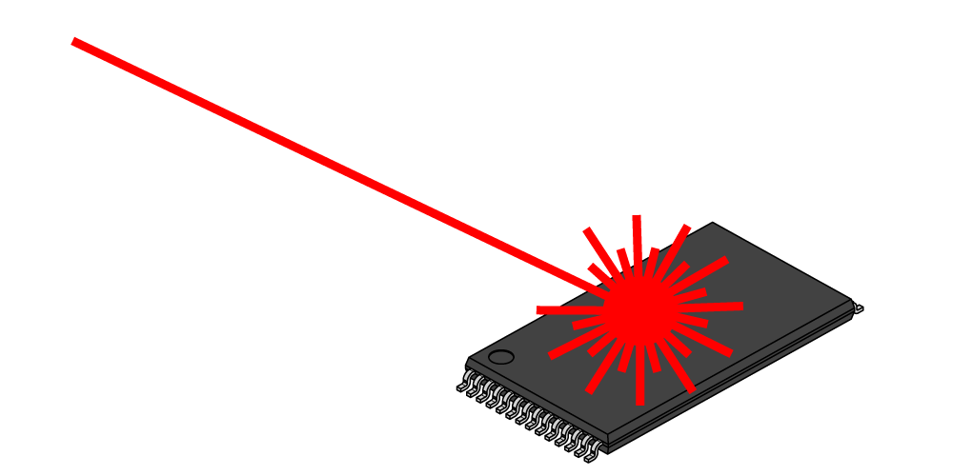
Variety of Side Channels
Different target systems implies different methods for observing.
Fault attacks
Requires access to the hardware.
Simple power analysis
Requires proximity to the system.
Power consumption measurement mapped to behavior.
Different power analysis
Requires proximity to the system.
Statistics and error correction gathered over time.
Timing attacks
Requires same process co-location.
Network packet delivery, cache misses, resource contention.

Slide 7
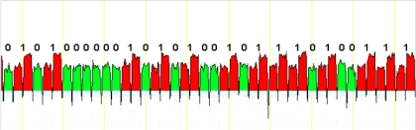
Example targeting Cryptography
“In cryptography, a side-channel attack is any attack based on information gained from the physical implementation of a cryptosystem”
Medium matters
Attackers have ability to measure system as black box
RSA bits leaked through Power Analysis

Slide 8
What happens
Information gained through recordable changes in the system
t = n
RSA Implementation:
The Black Box
Powered sampled at even intervals across time.
P
> T

Slide 9
Basic side channel requirements
Medium agnostic
Side channels require 3 primitives: - Transmit - Receive - Shared environment
Target
Malicious actor
“Transmitor”
leak artifacts
“Receiver”
measure artifacts
Shared Enviornment
Notes:
Combine these primitives in different ways…...3 slides

Slide 10
Types of side channel attacks: Scenario 1
Receiver (Eavesdropper): Record information from the shared environment.
Transmitter: Unaware target. Operating as normal.
Applications include:
- crypto key theft - process monitoring - environment keying - broadcast signal

Slide 11
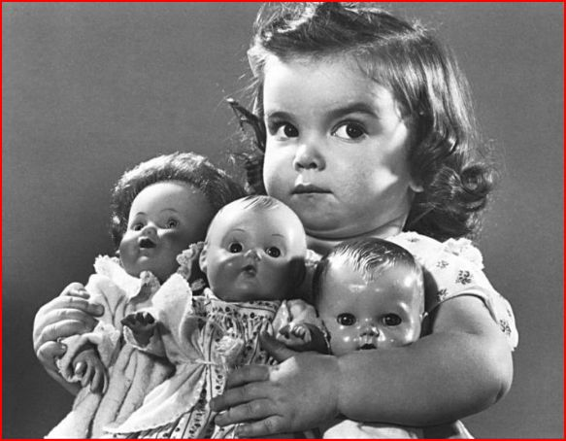
Types of side channel attacks: Scenario 2
Receiver (Unaware): Non-existent. All other processes on system do not intentionally record artifacts.
Transmitter (Aware): Intentionally sends artifacts into the shared environment.
Applications include:
- DoS attack - Proof of co-residency

Slide 12
Types of side channel attacks: Scenario 3
Receiver: Records system artifacts and translates into a meaningful message.
Transmitter: Intentionally sends artifacts into the shared environment.
Caveats: All processes to have both and agree on time, pre-arrange message translation.

Slide 13
Types of side channel attacks: Scenario 3
Applications Include: Communication channel.
Virtual Allocations
VM1
VM2
Client
Master VM
T
R
T
R
T
R
Communication Medium
Shared Hardware

Slide 14
Overview
Side channel attacks
Side channel mediums: Hardware
Vulnerabilities in the cloud
Demo
Defenses
The future

Slide 15
Communication Between Processes Using Hardware
Malicious Transmitter
Malicious Receiver
Hardware

Slide 16
Available Hardware
Shared environment on computers, accessible from software processes. Hardware resources shared between processes.
- Processors (CPU/ GPU) - Cache Tiers - System Buses - Main Memory - Hard Disk Drive

Slide 17
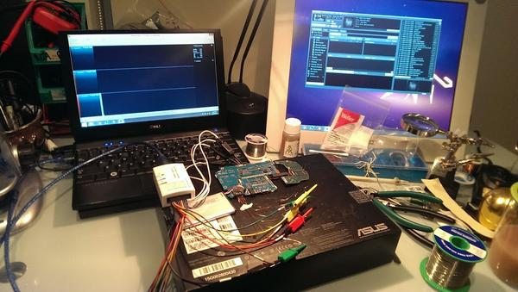
Hardware side channels compared to other types
Sender (Transmitter) process
Affect the state of the shared hardware
Must be observable/ recordable from other processes
Repeatable
Receiver process
Record the state of the shared hardware
Must observe without affecting the transmitted state.

Slide 18
Side Channel attacks over Hardware
Primitives
Processes share hardware resources
Dynamic translation based on need
Allocation causes contention
Notes:
Process behaviors not opaque

Slide 19

Physical co-location leads to side channel vulnerabilities.
wat

Slide 20

The Cloud

Slide 21
Overview
Side channel attacks
Side channel mediums: Hardware
Vulnerabilities in the cloud
Demo
Defenses
The future

Slide 22
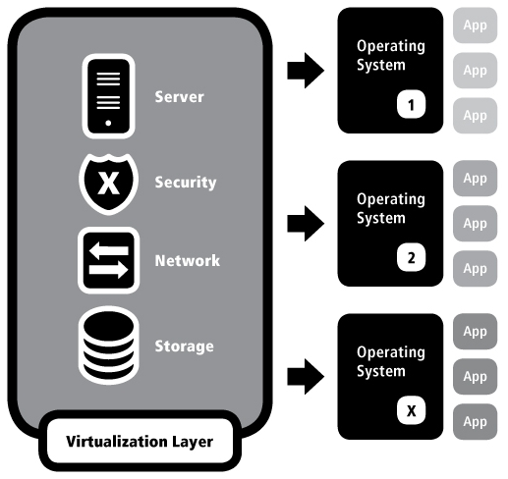
Cloud Computing (IaaS)
Perfect environment for hardware based side channels:
Virtual instances
Hypervisor schedules resources between all processors on a server
Dynamic allocation
Reduces cost

Slide 23
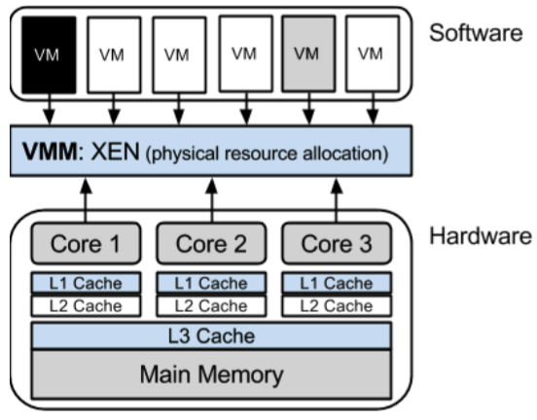
Vulnerable Scenarios in the Cloud
Sensitive data stored remotely
Vulnerable host
Untrusted host
Co-located with a foreign VM

Slide 24
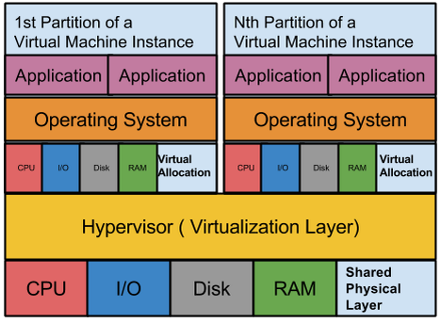
Neighbor virtual machines
Sharing hardware allocations.

Slide 25
Hardware Side Channels in the Cloud

Slide 26
Cloud Computing Side Channel - Primitives
Medium: Shared artifact from a hardware unit Cross VM: Virtual machine or process Method: Information gained through recordable changes in the system Vulnerability: Translation between physical and virtual, dynamic!
Notes:
We basically want to create a Side Channels which Exploit Hardware Vulnerabilities Inherent to Modern Cloud Computing Systems

Slide 27
Cloud Computing Side Channel
Shared hardware Dynamically allocated hardware resources Co-Location with adversarial VMs, infected VMs, or Processes ( requires SMT )
VM
VM
VM
VM
VM
P
P
P
P
P
P
H
H

Slide 28

Build Your Own Side Channel: Hardware
Choose Medium: Measure shared hardware unit’s changes over time
Cache
Processor
System Bus
Main Memory
HDD
Notes:
Vulnerabilities shared by each hardware unit
Attack model applied to each
Differences with creating side channels across each unit

Slide 29
Build Your Own Side Channel: Measurement
Choose Vulnerability: Measure artifact of shared resource.
Timing attacks (usually best choice)
Cache misses, stored value farther away in memory
Value Errors
Computation returns unexpected result
Resource contention
Locking the memory bus
Other measurements recordable from inside a process, in a VM
Notes:
Mentioned power , fault attacks earlier, don’t apply to cloud.
Attack model applied to each
Differences with creating side channels across each unit

Slide 30
Build Your Own Side Channel: Attack Model
Choose S/R Model: What processes are involved in creating the channel depend on intended use cases.
Scenario 1: Transmit only
Application: DoS Attack
Sender only
Scenario 2: Record Measurements
Application: Crypto key theft
Receiver only
Scenario 3: Bi-way Channel
Application: Communication channel
Sender and Receiver
Notes:
Mentioned power , fault attacks earlier, don’t apply to cloud.
Differences with creating side channels across each unit

Slide 31
Some channels are easier than others….
Case Study 1: Locking the memory bus
Pro: efficient, no noise, good bandwidth
Con: highly noticeable
Case Study 2: Everyone loves Cache.
Pro: hardware medium is ‘static’
Con: most common, mitigations are quickly developed
Notes:
The cache (and any shared memory model) is the easiest to attack and most common

Slide 32
Some channels are easier than others….
Technical Difficulties:
Querying the specific hardware unit
Difficulty/ reliability unique to each hardware unit
Number of repeated measurements possible
Frequency of measurements allowed

Slide 33
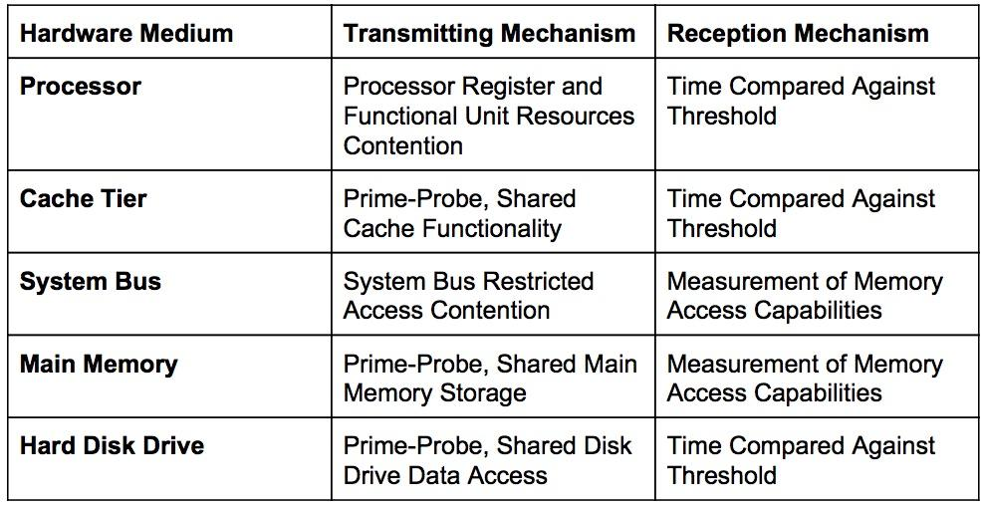
Measurement methods for different hardware units

Slide 34
Measurement methods for different hardware units
Medium | Transmission | Reception | Constraints
L1 Cache | Prime Probe | Timing | Need to Share Processor Space
L2 Cache | Prime Probe/ Preemption | Timing | Caches Missing Causes Noise
Main Memory | SMT Paging | Measure Address Space | Peripheral Threads Create Noise
Memory Bus | Lock & Unlock Memory Bus | Measure Access | Halts all Processes Requiring the Bus
CPU Functional Units | Resource Eviction & Usage | Timing | mo' Threads, mo' Problems
Hard drive | Hard Disc Contention - Access Files Frantically | Timing | Dependent on multiple readings of files

Slide 35
Overview
Side channel attacks
Side channel mediums: Hardware
Vulnerabilities in the cloud
Demo
Review of discovery primitives
Defenses
The future

Slide 36
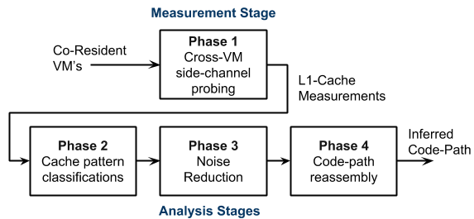
Example: Probing the Cache
Applied to a L1 cache side channel

Slide 37
Demo 1: Side channel setup
Medium: Shared L3 Cache Tier
Vulnerability: Timing attacks
Cache misses, stored value farther away in memory
Model: Scenario 2 Record Measurements
Application: Crypto key theft
Receiver only
General setup: Cross processes.

Slide 38
Demo 1: Flush+Reload Attack [1]
Receiver: ‘Attacking’ Process
forcing victim code out of the L3 Cache
measuring time it takes to access it
Transmitter: Victim process
performing RSA encryption
uses target code between the flush and reload of adversary
Requires:
Timing
Knowledge of target code
1. Yuval Yarom, Katrina Falkner. July 18, 2013. FLUSH+RELOAD: a High Resolution, Low Noise, L3 Cache Side-Channel Attack.

Slide 39
Demo 1: Measuring the L3 Cache Tier
Sources
https://defuse.ca/flush-reload-side-channel.htm
https://github.com/DanGe42/flush-reload

Slide 40
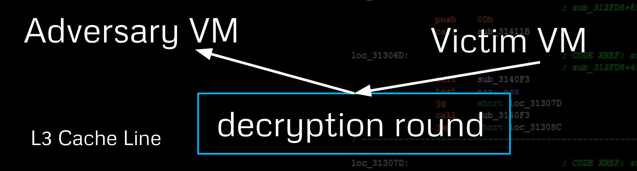
Demo 1: Results
Successfully leaked the private key from the GnuPG
Leaked 96.7% bits of the secret key

Slide 41
Demo 2: Side channel setup
Medium: CPU Pipeline
Vulnerability: Erroneous Values
SMT optimizations, different values possible
Model: Scenario 3
Application: Communicate a signal.
Sender and receiver
General setup: Cross VM.
Notes:
Explain thesis
We chose to target the processor as the hardware medium. Why?

Slide 42
Out-of-Order-Execution

Slide 43
Demo 2: Out-of-Order Execution Attack
Receiver: Measuring Process
Hardware medium must be measured dynamically unlike the cache.
Instruction order, results from instruction sets
Transmitter: Sending process
Force the pipeline state to optimize a certain way…..
Or not optimize, memory fences
Requires:
Timing
Pre-arranged encoding
1. D’Antoine Sophia May 21, 2015. Exploiting processor side channels to enable cross VM malicious code execution
Notes:
Dynamic querying/ forcing method
Application: cloud computing
Mitigation techniques: Information and time frames
⇒ Demonstration of a novel Out of Order Execution side channel.

Slide 44
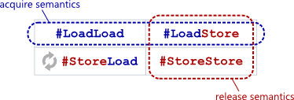
Demo 2: Transmitting out-of-order-executions
Force Deterministic Memory Reordering:
Compile-time vs Runtime Reordering
Runtime:
Usually strong memory model: x86/64 (mostly sequentially consistent)
Weaker models (data dependency re-ordering): arm, powerpc
Barriers:
4 types of run time reordering barriers
Notes:
OoOE Execution MultiCored (MultiExecution Processors) Computers

Slide 45
Demo 2: Transmitting out-of-order-executions
Force Out of Order Execution: Memory fences
Mfence:
x86 instruction full memory barrier
prevents memory reordering of any kind
order of 100 cycles per operation
Lock-free programming on SMT multiprocessors
… mov dword ptr [_spin1], 0
… mfence
… mov dword ptr [_spin2], 0
… mfence

Slide 46
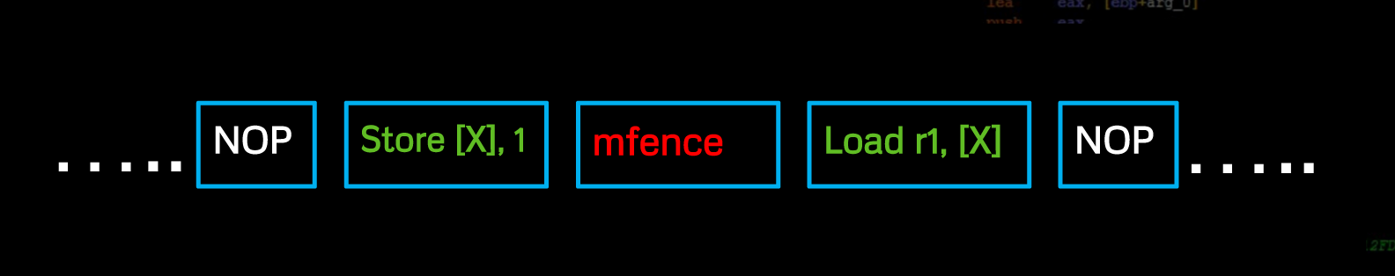
Notes:
Time frame dependant

Slide 47
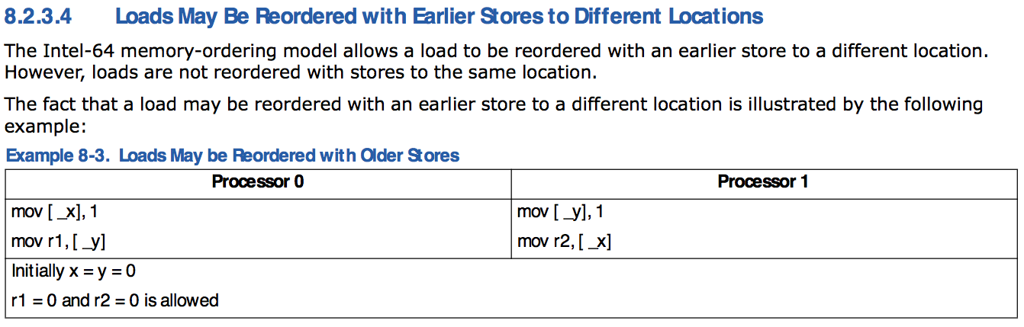
Demo 2: Receiving out-of-order-executions

Slide 48
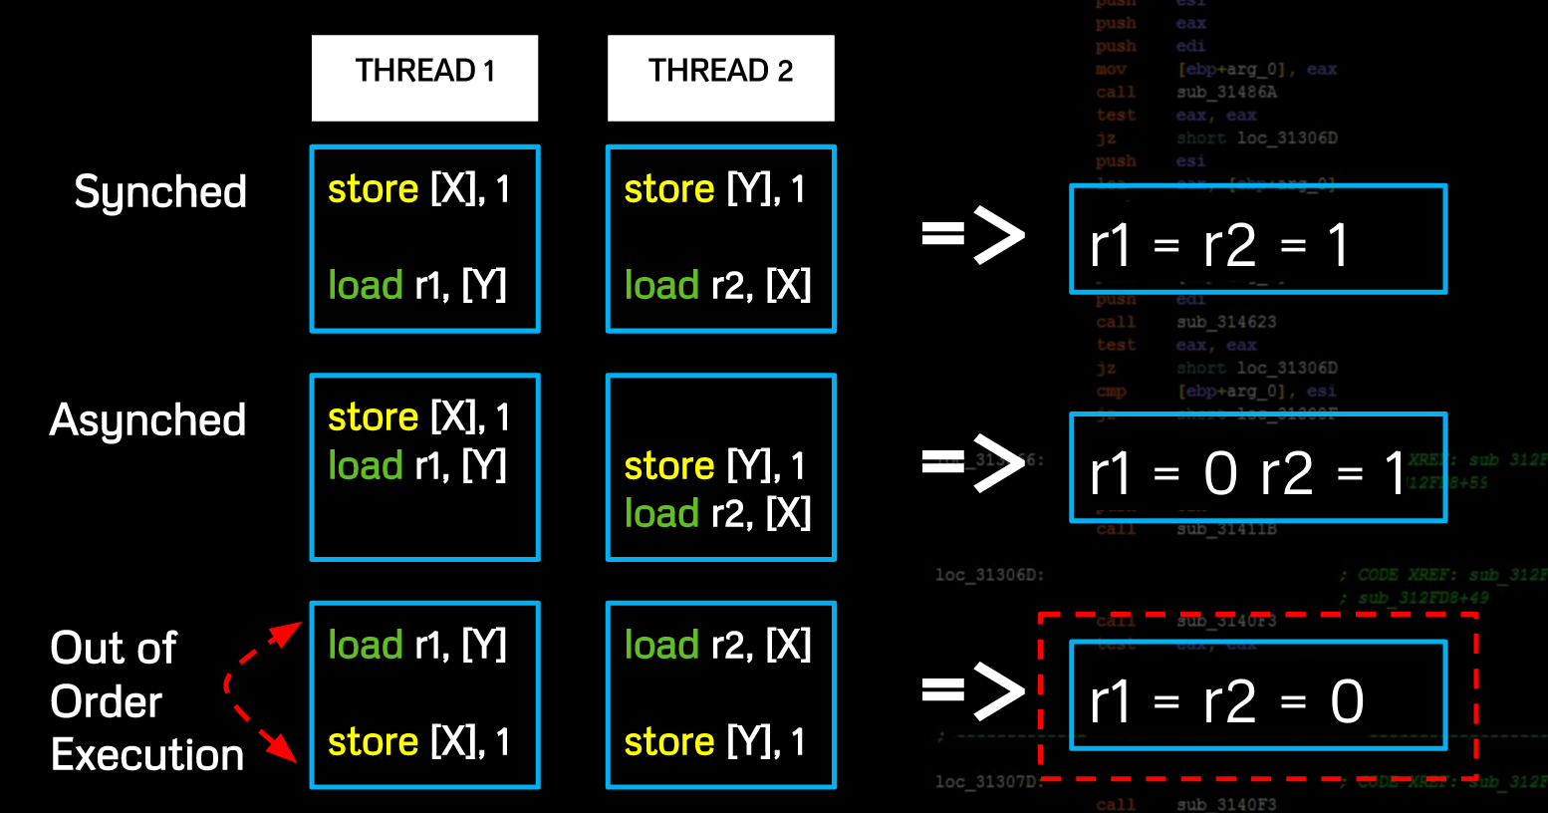

Slide 49
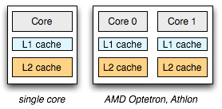
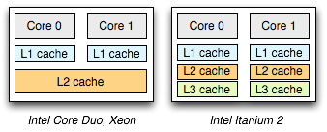
Demo 2: Hardware Architectures
Lab Setup:
Intel’s Core Duo, Xeon Architecture
Each processor has two cores
The Xen hypervisor schedules between all processors on a server
Each core then allocates processes on its pipeline
Notes:
Multiple processes run on a single pipeline (SMT)
Relaxed memory model

Slide 50
Demo 2: VM Processor Contention
VM
VM
VM
VM
Process01
Process02
Process03
Process04
SMT Optimizes Shared Hardware
Core01
Core02
Pipeline Executing Instructions From Foreign Applications
Processor
Notes:
Windows 7 with noise processes

Slide 51
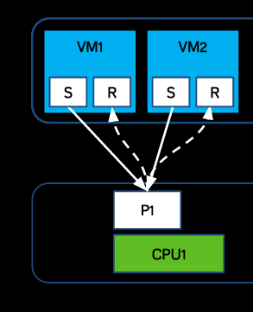
Demo 2: VM Processor Contention
Notes:
Windows 7 with noise processes

Slide 52
Demo 2: Measuring the Pipeline
Sources & Paper
http://www.sophia.re/SC

Slide 53
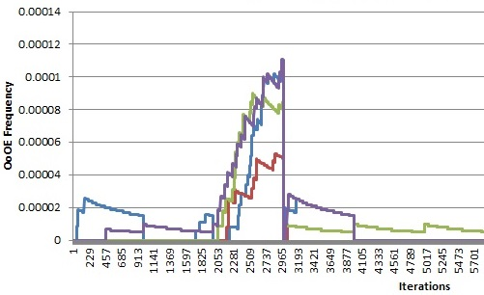
Demo 2: Results
Process changes signature of queried hardware unit over time

Slide 54
Demo 2: Results
Benefits:
Harder for a intelligent hypervisor to detect, quiet
Eavesdropping sufficiently mutilates channel
System artifacts sent and queried dynamically
Not affected by cache misses
Channel amplified with system noise

Slide 55
Overview
Side channel attacks
Side channel mediums: Hardware
Vulnerabilities in the cloud
Demo
Defenses
The future

Slide 56
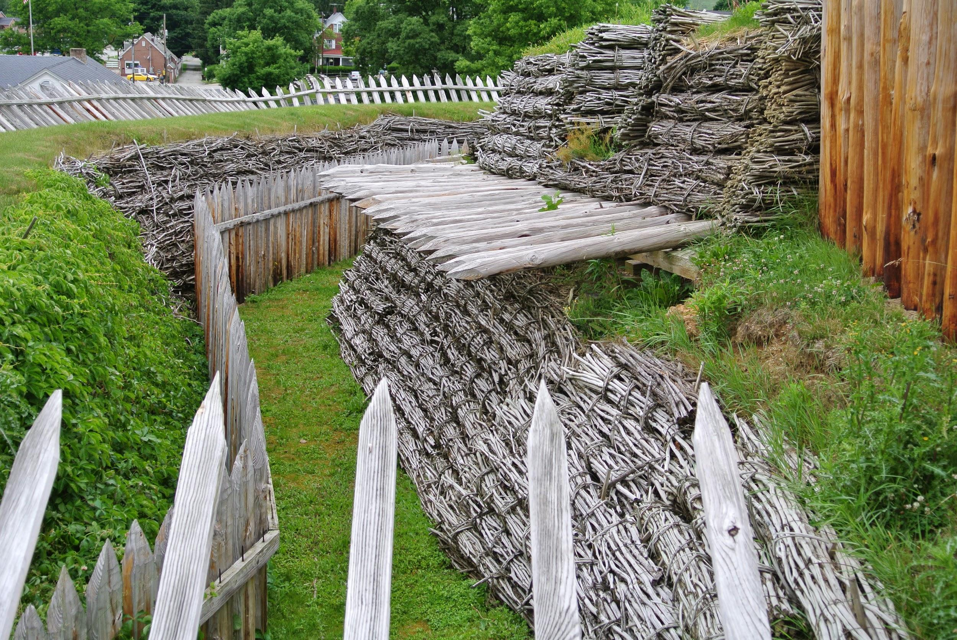
Defensive mechanisms: Hardware
Protected Resource Ownership:
Isolating VM’s
Turn off hyperthreading
Blacklisting resources for concurrent threads
Downside: removes optimizations or benefits of the cloud

Slide 57
Defensive mechanisms: Hypervisor
Anomaly detection:
Specification
Pattern recognition
Records average OoOE patterns
Predicts what to expect

Slide 58

Defensive mechanisms: Software
Control Flow Changes:
Hardening software with Noise
Force specific execution patterns (i.e. constant time loops, ...)
Avoid using certain resources
Downside: compiler, hardware optimizations lost
Notes:
Research area for us at ToB

Slide 59
Overview
Side channel attacks
Side channel mediums: Hardware
Vulnerabilities in the cloud
Demo
Defenses
The future

Slide 60
Our Future in the Cloud
Side Channel Potential:
More resource sharing
More dynamic optimizations
Virtualization more popular
Malware
Things to Consider:
Cloud Side Channels apply to anything with virtualization (i.e. VM’s)
Hypervisors are easy targets: Vulnerable host
i.e. “Xenpwn”, paravirtualized driver attack: INFILTRATECon 2016

Slide 61

Conclusion
What is a side channel
Primitives for hardware based side channels
Co-location
Medium
Transmit the artifact
Record/ observe the artifact
Different mediums in the cloud
Variety of possible attacks
Cross VM and process

Slide 62


Acknowledgements
Jeremy Blackthorne RPISEC Trail of Bits

Slide 63

Any Questions?
IRC: quend Email: sophia@trailofbits.com Website: http://sophia.re/SC

Slide 64
References
https://www.usenix.org/system/files/conference/usenixsecurity14/sec14-paper-yarom.pdf
http://bartoszmilewski.com/2008/11/05/who-ordered-memory-fences-on-an-x86/
http://preshing.com/20120913/acquire-and-release-semantics/
http://www.intel.com/Assets/en_US/PDF/manual/253668.pdf
http://preshing.com/20120930/weak-vs-strong-memory-models/
http://en.wikipedia.org/wiki/Memory_barrier#An_illustrative_example
http://preshing.com/20120710/memory-barriers-are-like-source-control-operations/
http://gauss.ececs.uc.edu/Courses/c653/lectures/SideC/intro.pdf
https://www.ernw.de/download/xenpwn.pdf

Slide 65
Extra Slides

Slide 66
Receiver: Record out of order executions
int X,Y,count_OoOE; ….initialize semaphores Sema1 & Sema2… pthread_t thread1, thread2; pthread_create(&threadN, NULL, threadNFunc, NULL); for (int iterations = 1; ; iterations++) X,Y = 0; sem_post(beginSema1 & beginSema2); sem_wait(endSema1 & endSema2); if (r1 == 0 && r2 == 0) count_OoOE ++;
Notes:
Averages matter

Slide 67
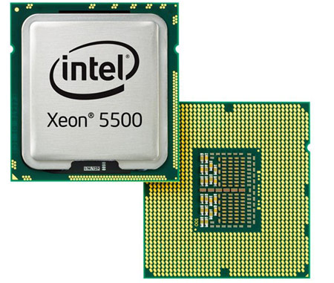
Details of Demo 2: Pipeline Side Channel Setup
Scheduler Xen hypervisor: Popular commercial IaaS platforms
Xeon Processors Shared multi-core/ multi-processor hardware 8 logical CPU’s/ 4 cores 6 virtual machines (VM’s) Parallel Processing/ Simultaneous Multi-Threading On (SMT)

Slide 68
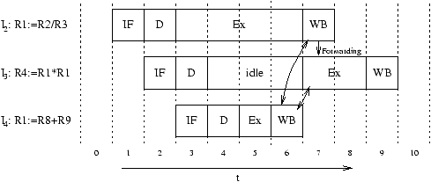
Details for Demo 2: Pipeline Reordering

Slide 69
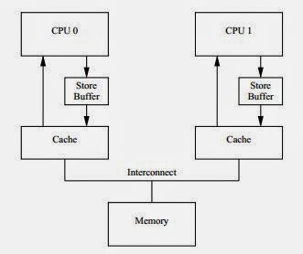
Details for Demo 2: Pipeline Reordering

